Slide 1



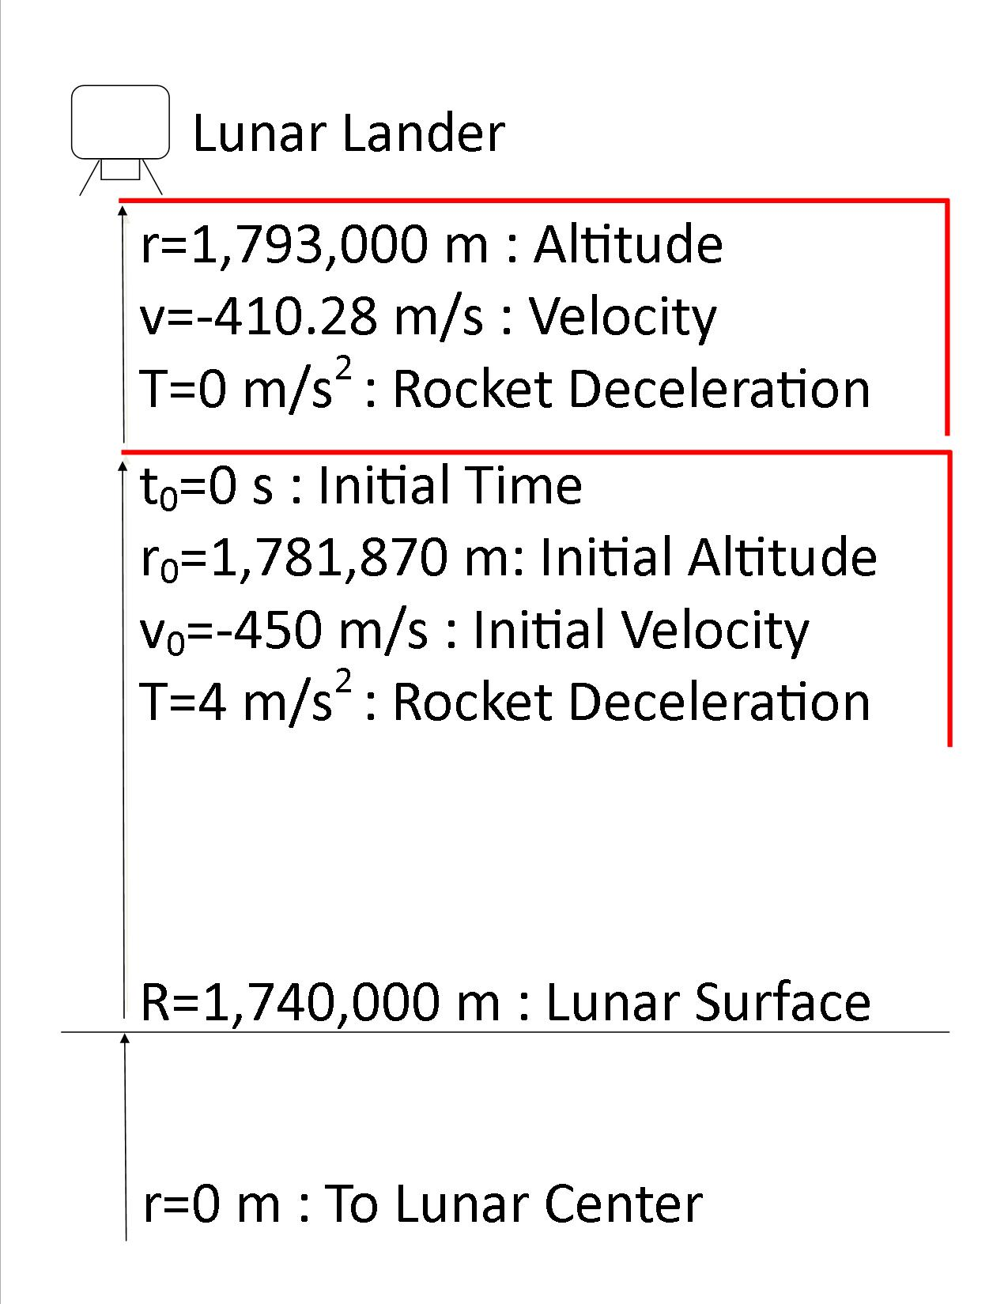
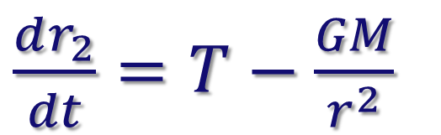



Predicting Reliable Landing Time and Initial Velocity
For a Lander in a Two-Body System
Department of Mathematics & Physics
Sponsored By DMACC Honors Program
Carl De Vries and JJ Xue Hu
ABSTRACT
CASE STUDY
CASE STUDY
Analytically integrating an ordinary differential equation (ODE) for an initial value problem yields a function with solutions when evaluated at given points. However, some ODEs cannot be solved analytically, and require a numerical method to calculate an approximate solution. This parameter study investigates the reliability of estimations made from best-fit curves that are based on a set of numerical approximations. The results indicate interpolations are consistently more accurate than extrapolations, and show decreasing reliability as the distance from the data set grows. Our analysis suggests increasing the number of data points and the size of the domain is the best technique for improving estimations.
INTERPOLATION
THEORY
At an altitude of 1,793,000 m measured from the center of the moon, a lunar lander is accelerating downward at
-410.28 m/s. A retrorocket must ignite to decelerate the lander to achieve a soft landing.
Using Newton’s second law and Newton’s law of gravitation to describe the lander’s net acceleration, the following system of equations is created to describe the lander’s decent.
INITIAL CONDITIONS:
Initial time: x₀ = 0 s
Initial altitude: y₀[0] = 1,781,870 m
Initial velocity: y₀[1] = -450 m/s
Upper limit of integration: x_{n} = 200 s
Number of steps: n = 200
CALCULATION:
Step size: h = $\frac{\text{x}\text{n}\text{ − }\text{x}\text{0}}{\text{n}}$ = 1 s
RESULT:
The output data from the program is an exact match to the provided case study values.
EXTRAPOLATION
Altitude:
$$r(t)$$
Velocity:
$$\frac{dr_{1}}{dt}=v$$
Acceleration:
$\frac{dr_{2}}{dt}=T−\frac{GM}{r^{2}}$
PARAMETER STUDY
Where T, G, an M are constants.
The non-linear ODE can’t be solved analytically. A numerical method, 4th order Runge-Kutta (RK4), is utilized to approximate the landing time and the landing velocity.
The dependent variable is the deceleration from thrust. The data set consists of twenty-one points spaced in increments of 0.05 within the domain, T∈ [3.5,4.5]. The independent variables, time and starting velocity, are approximated by running RK4 trials until a landing solution meets specified tolerances.
Exact solutions are unrealistic with an integer time step.
The tolerances for landing altitude and landing velocity are within ±5 m of the lunar surface and ±1 m/s of a complete stop. Tolerances were chosen based on their negligible size compared to initial altitude and initial velocity values.
The data set is fit to a 2nd order polynomial curve using Microsoft Excel. To examine the accuracy of the best-fit curves, 6 interpolations and 8 extrapolations were compared with RK4 solutions. The equations for the best-fit curves are as follow.
CONCLUSION
All interpolations were within 0.3% of the RK4 values, thus, confirming estimations are reliable within the domain of the data set.
Extrapolations within ±0.25 of the domain were within 1% of the RK4 values, showing the best-fit curve is reliable short distances beyond the domain.
The Time vs. Deceleration from Thrust curve has a minimum within the extrapolation domain at T=5.49. Points beyond the minimum are unreliable due to the divergence of the best-fit curve and the true data trend.
A cubic function improves accuracy for extrapolations within ±1 of the data set. Higher order polynomials are unreliable due to changes in concavity.
Quadratic and cubic accuracy can be improved by widening the domain.
Further extrapolations suggest a power best-fit curve improves accuracy for Time vs. Deceleration from Thrust and a logarithmic curve is best suited for Initial Velocity vs. Deceleration from Thrust.
CASE STUDY SOURCE: Edwards, C. Henry, and David E. Penney. Differential Equations & Boundary Value Problems Computing and Modeling. 4th ed. Upper Saddle River: Pearson Custom, 2008. Print.
RK4 requires an initial condition for the altitude [r₀] and velocity [v₀] at ignition. To solve for the values:
Use a chain rule substitution
Separate the variables
Solve 1st order ODE when T=0
Solve 1st order ODE when T=4
Set the equations equal to each other and solve
4th ORDER RUNGE-KUTTA:
RK4 is highly accurate for integrating along smooth curves. The method was implemented as a C++ program to automate the approximation process.
Time vs. Deceleration from Thrust:
y = 13.32x² - 146.27x + 558.9
Initial Velocity vs. Deceleration from Thrust:
y = 9.6619x² - 170.64x + 77.986

